Slide 1



FUNDAMENTALS OF GENERATIVE AI FOR ITEM DEVELOPMENT
Henry Makinde, Hope Adegoke, Mubarak Mojoyinola

Slide 2



About Us
Henry Makinde | Hope Adegoke | Mubarak Mojoyinola
PhD Candidate University of North Carolina, Greensboro | PhD Student University of North Carolina, Greensboro | PhD Candidate University of Iowa, Iowa City

Slide 3
Agenda
Introduction of Generative AI and Item Generation
Basic Langchain Training
Prompt Engineering
RAG
Fine-tuning
Agents
Project

Slide 4
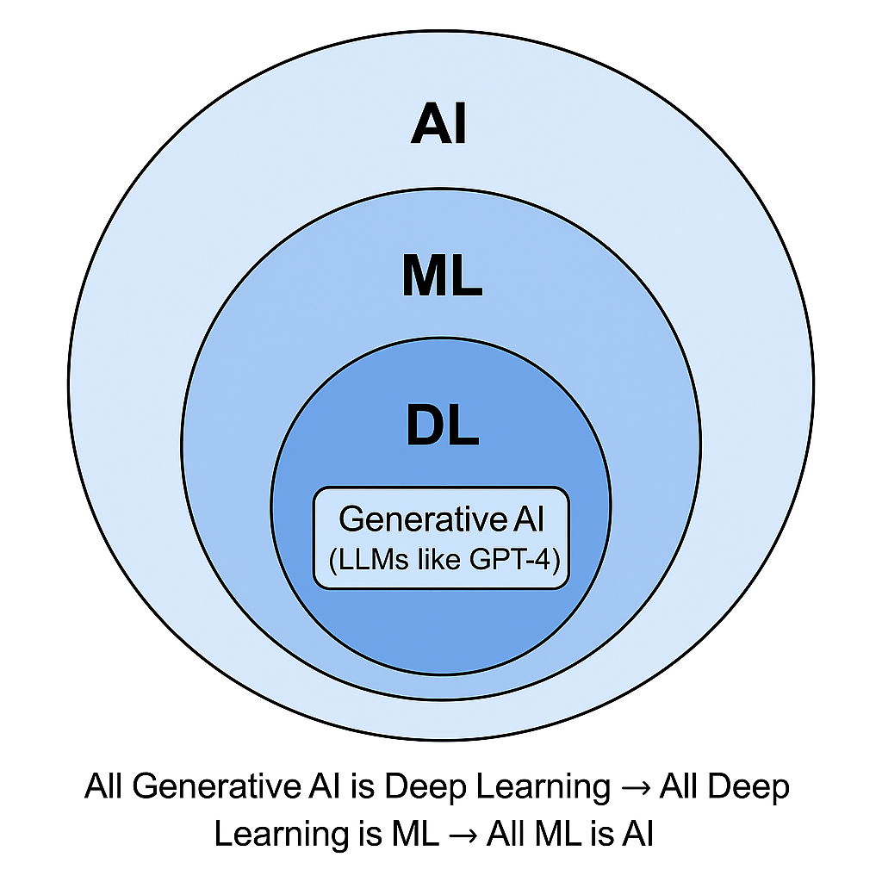
WHAT IS ARTIFICIAL INTELLIGENCE
Artificial intelligence is a branch of computer science that deals with the creation of intelligent agents that can reason learn and act autonomously.
Notes:
Generative AI is a form of artificial intelligence; therefore, it is only just that we start with a clear definition of AI. Next, we will talk briefly about ML and DL before talking deeply about generative AI

Slide 5
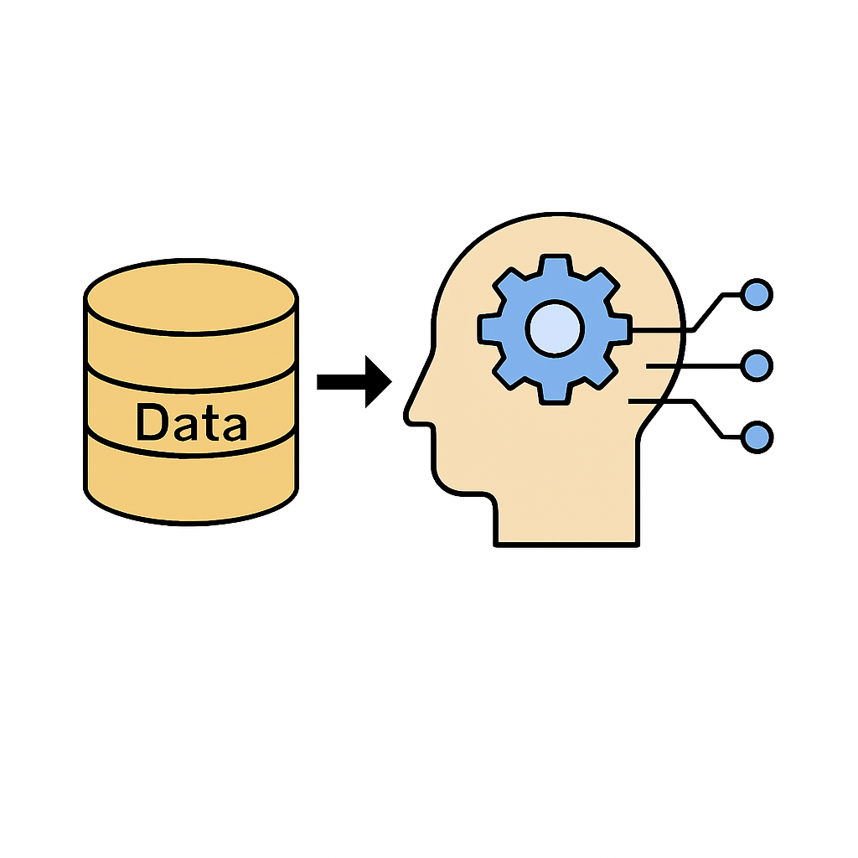
MACHINE LEARNING
A subset of AI that uses data to train algorithms to make decisions or predictions.
Popular ML Models
Supervised: Uses labeled data to predict future outcome
Unsupervised: Uses unlabeled data to find hidden structure

Slide 6
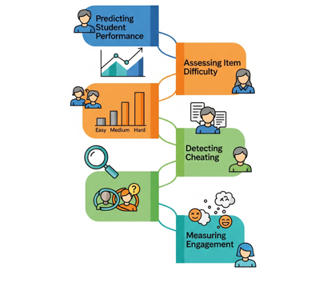
ML APPLICATIONS IN ED MEASUREMENT
Supervised Models
Predicting student performance
Predicting item difficulty
Detecting cheating
Predicting student engagement
Yildirim-Erbasli & Bulut (2022); Zhou & Jiao (2022)
Notes:
Detecting cheating: Zhou & Jiao (2022) Predicting student engagement: Yildirim-Erbasli & Bulut (2022)

Slide 7
ML APPLICATIONS IN ED MEASUREMENT
Unsupervised Models
Detecting aberrant responses
Identifying learning strategies
Feature generation for predictive models
Gorgun & Bulut (2022); Jiao et al 2023
Notes:
Gorgun & Bulut (2022) used unsupervised anomaly detection methods to identify aberrant responses in an intelligent tutoring system Jiao et al 2023 used anomaly detection algorithm to generate features for cheating detection ML model.

Slide 8
DEEP LEARNING
A subset of ML that uses artificial neural networks to process more complex patterns than typical ML models.
Applications In Ed Measurement
Automated scoring
Cheating detection
Lottridge et al.,(2023)
Notes:
Lottridge et al.,(2023) used deep learning for automated scoring

Slide 9
WHAT IS GENERATIVE AI
Generative AI is a type of artificial intelligence technology that can generate new content such as text, images, audio and video based on learned patterns.
It uses statistical model to predict an expected response based on given prompt.
A prompt is a short text that is given to a generative model as input to control its output

Slide 10
TYPES OF GENERATIVE AI
Generative language models
These models take text as input and generate new text.
Generative image models
These models take an image or text as input and generate new images, captions, or even videos.
Multimodal models
These models take text, images, or audio as input and can generate text, images, audio, or video.
Notes:
Generative AI is a broader term for collection of models that can generate new output. This slide provides specific terms for Gen AI models based on their input and output capabilities

Slide 11
LARGE LANGUAGE MODELS (LLM)
LLMs refers to large, general-purpose language models that can be pre-trained and then fine-tuned for specific purposes.
Pretraining: Involves exposing the model to a vast collections of text that encompass numerous subjects allowing the model to acquire a wide-ranging comprehension of how language operates.

Slide 12
GENERAL LLM USE CASES
Text classification
Sentence completion
Question answering
Language translation
Content Generation

Slide 13
COMMON LLMS
Closed-source
Open-source
GPT
Claude
Gemini
Grok
Llama
Mistra
Qwen

Slide 14
LLM APPLICATIONS IN ED MEASUREMENT
Automated scoring
Item difficulty prediction
Alignment study
Automated item generation

Slide 15
QUICK AIG FUNDAMENTALS
Automatic Item generation (Gierl & Haladyna, 2012) is the process of using item models/Item shells/Item templates to generate test items with the aid of computer technology. Traditionally, this is done with template-based models.
Create Cognitive Model
Extract
Create Item Model
Instructions
Generate Test Items
Parameters and Constraints
Parameters and Constraints
Gierl.et.al 2021

Slide 16
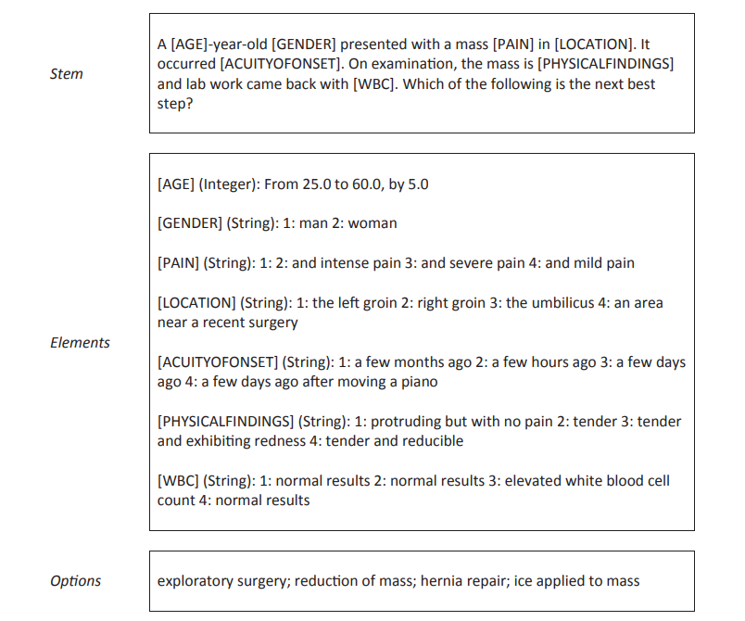
ITEM SHELL/TEMPLATE
TEMPLATE BASED AIG

Slide 17
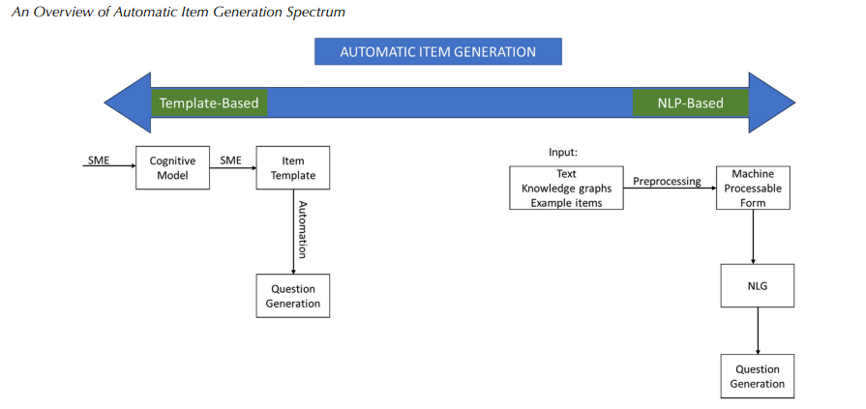
NON-TEMPLATE BASED AIG
GENERATIVE AI/ LLM
Adopted from Gorgun (2024).

Slide 18
AIG METHODS WITH LARGE LANGUAGE MODELS
Prompt Engineering
RAG
Fine Tuning: Von Davier 2019 (Finetuned GPT2 for a week with Pubmed Data)
AGENTS
Notes:
Look for Examples

Slide 19
LLM PROMPTING
Direct instruction of pre-trained models using carefully crafted prompts to generate items without additional training.
Pros
Fast deployment
Flexible
Low cost
Cons
Inconsistent quality
Context limitations
Limited domain specificity
Notes:
Fast deployment: Can immediately generate questions by providing clear instructions to existing pre-trained models.
Flexible: Easy to modify prompts for different subjects, difficulty levels, question types, or educational contexts without model retraining.
Low cost: Eliminates the need for specialized datasets, computational resources for training, or technical expertise in model fine-tuning.
Inconsistent Quality: Output quality heavily depends on prompt engineering skills and may produce variable results across different topics or question types.
Context Limitations: Restricted by the model's context window and may struggle with complex educational scenarios requiring extensive background knowledge
Limited Domain Specificity: May lack deep understanding of specific curriculum standards, educational frameworks, or subject-matter nuances compared to fine-tuned models.

Slide 20
TYPES OF PROMPTING
Zero-Shot Prompting
Few-Shot Prompting
Chain-of-Thought Prompting

Slide 21
IMPLEMENTATION
Direct use of ChatBot like (ChatGPT, Claude, Gemini, Deepseek)
API Calls
Feature | API Calls | Chatbot Interface
Control | Full Control | Limited Control
Automation | Full Automation | Limited Automation
Cost Efficiency | Transparent Pricing | Subscription
Ease of Use | ⭐⭐ | ⭐⭐⭐⭐⭐
Prompt Engineering | Engineering Capabilities | CustomGPT
Integration | Seamless Integration | Manual Integration
Data and Privacy | Data Control | Shared Environment
Consistency | Consistent Results | Variable Results
Notes:
Chatbot Interface: Limited Control
Fixed temperature/parameters set by provider
Can't adjust token limits precisely
No access to advanced sampling parameters
Limited system message control
Single-turn prompting mostly Limited few-shot examples (context window constraints) Can't control conversation flow precisely
Integration:Manual Workflow
Type prompt → Get response → Copy result
Paste into document/system manually
Repeat for each item
Manual quality check

Slide 22
WHEN TO USE API/CHATBOTS
Use API Calls When:
Building production applications
Need automation/batch processing
Require precise control over parameters
Integrating with existing systems
Cost optimization is important
Need consistent, reproducible results
Company based project
Use Chatbot Interface When:
Quick prototyping and experimentation
Learning prompt engineering concepts
One-off content generation
Brainstorming and creative work
Non-technical users
Casual exploration of capabilities

Slide 23
RETRIEVAL-AUGMENTED GENERATION
RAG is the integration of external knowledge bases and educational resources with LLMs to enhance item generation by incorporating real-time access to curriculum materials, learning objectives, and assessment frameworks.
Pros
Enhanced accuracy and relevance
Scalable content integration
Cons
Complex system architecture
Retrieval quality dependency
Higher latency and costs
Notes:
Enhanced accuracy and relevance: Retrieves specific educational resources and context to generate questions that are factually accurate and closely aligned with learning materials and objectives.
Scalable content integration: Easily accommodates new educational resources, textbooks, or curriculum updates by simply adding them to the knowledge base without model modification.
Complex system architecture: Requires sophisticated infrastructure to manage retrieval systems, vector databases, and integration between retrieval and generation components.
Retrieval quality dependency: Item quality is heavily dependent on the effectiveness of the retrieval system; poor search results or irrelevant documents can compromise output quality.
Higher latency and costs: Processing involves multiple steps (retrieval + generation), leading to slower response times and increased computational costs compared to direct prompting approaches.

Slide 24
LLM FINE-TUNING
Finetuning involves further training the language model using a focused collection of educational data that is specifically tailored to match the intended application or objective.
Pros
Generate context-specific items
Consistent quality
Cons
Resource intensive
Data dependency
Limited flexibility
Notes:
In item generation context, finetuning enables the model to understand the specific characteristics of the education material and create questions that better match curriculum standards and learning goals.
Generate context-specific items: Develops deep understanding of educational content, curriculum standards, and pedagogical principles, resulting in highly relevant and contextually appropriate questions.
Consistent quality: Produces more reliable outputs that consistently match learning objectives, difficulty levels, and assessment criteria specific to the target educational domain.
Resource intensive: Requires significant computational power, specialized datasets, technical expertise, and time investment for training and validation processes.
Data dependency: Performance heavily relies on the quality and comprehensiveness of the training dataset; poor or biased data can lead to suboptimal question generation capabilities.
Limited flexibility: Once fine-tuned for specific domains or question types, the model may struggle to adapt to new subjects or formats without additional retraining.

Slide 25
AGENTS
Agents involve using autonomous or semi-autonomous AI components that can make decisions, perform tasks, and interact with other systems or users to achieve specific goals.
Pros
Automate complex multi-step workflows
Improve efficiency through reasoning and decision-making
Enable dynamic interaction (tool use, planning, and memory)
Cons
Hard to control or predict behavior fully
Require careful design and monitoring
May produce unintended or inconsistent outcomes

Slide 26
LLM ITEM GENERATION ACROSS DOMAINS
Reading comprehension
College algebra
Listening
Medical exams
Bedi et al.,(2024); Bhandari et al.,(2024); Runge et al.,(2024) ; Sayin & Gierl,(2024);

Slide 27
NOW LETS PRACTICE!!

